Slide 1
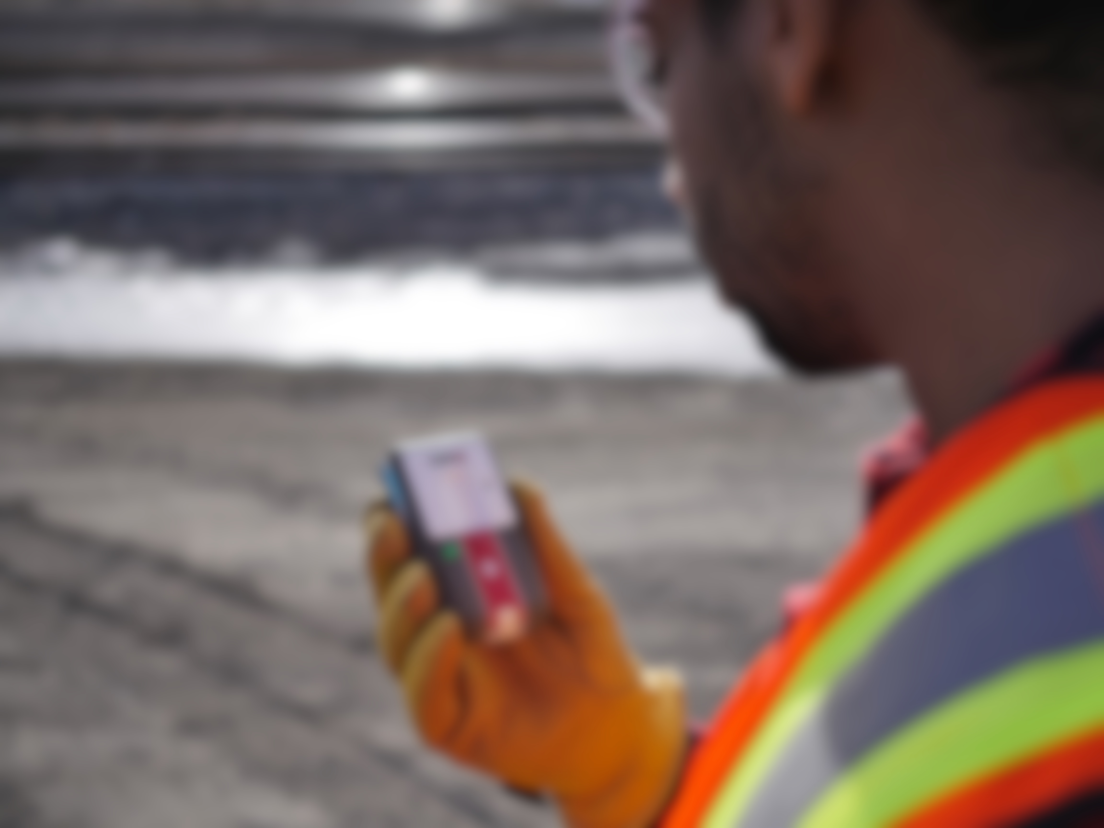
The Loner M6 Safety System

Slide 2
CONTENTS
About the device
Starting your shift
During your shift
Generating Manual Alerts
Receiving a voice call
Ending your shift
Questions?

Slide 3
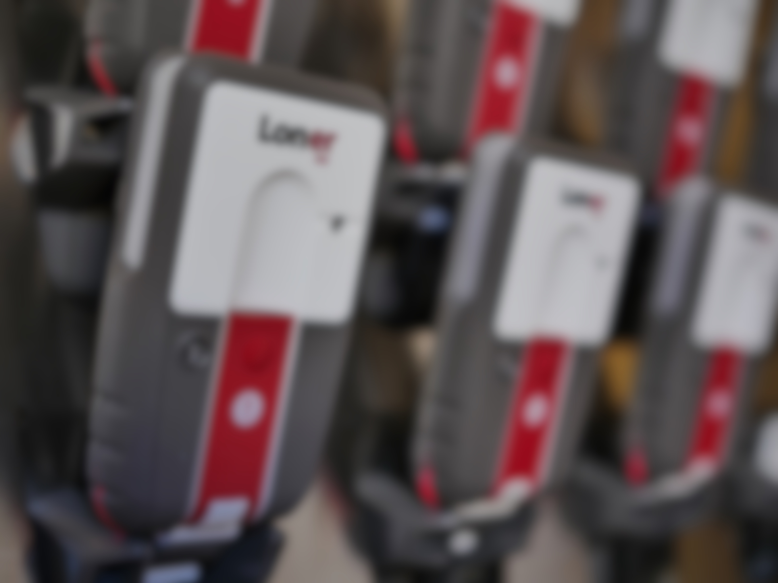
ABOUT THE DEVICE
Notes:
Is there any questions so far?
So now we’re going to talk about the physical components on each of the device so you can get familiar with the parts you’ll be interacting with while using it.

Slide 4
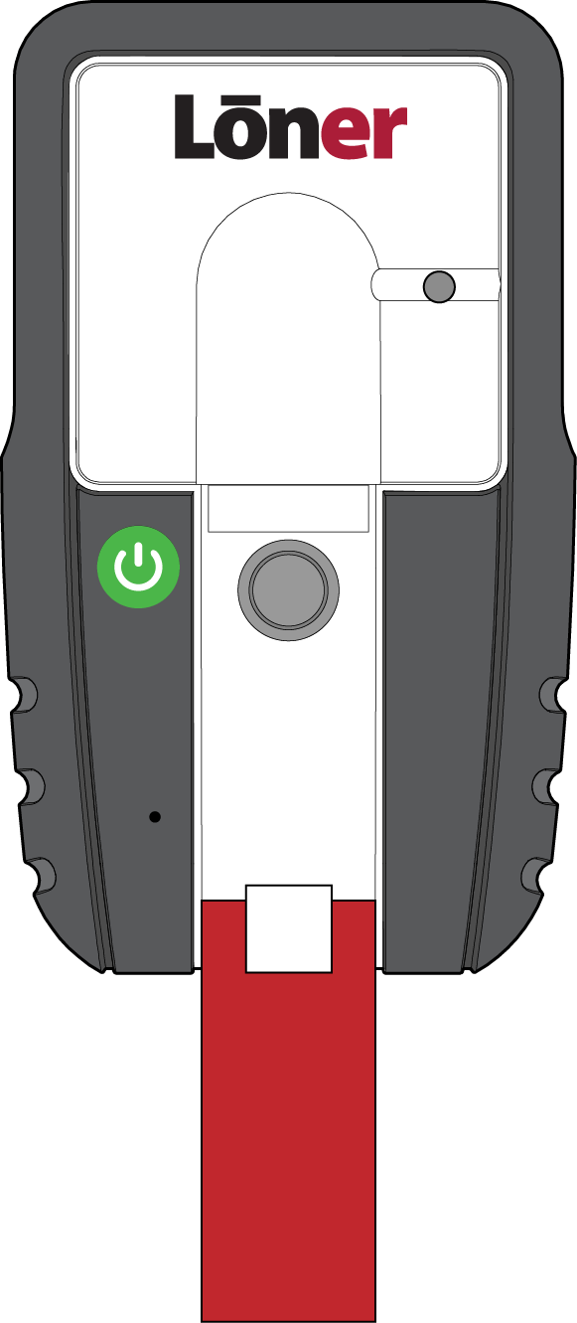
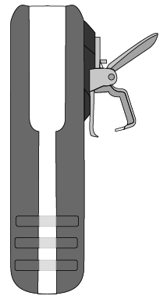

ABOUT THE DEVICE
There are three primary mechanical components of the Loner device.
Belt Clip
SureSafe monitoring light
and power button
Latch
Notes:
The Loner device has three primary components. The power, the belt clip, and the latch. We’ll talk more about how you’ll interact with these in the next section.

Slide 5
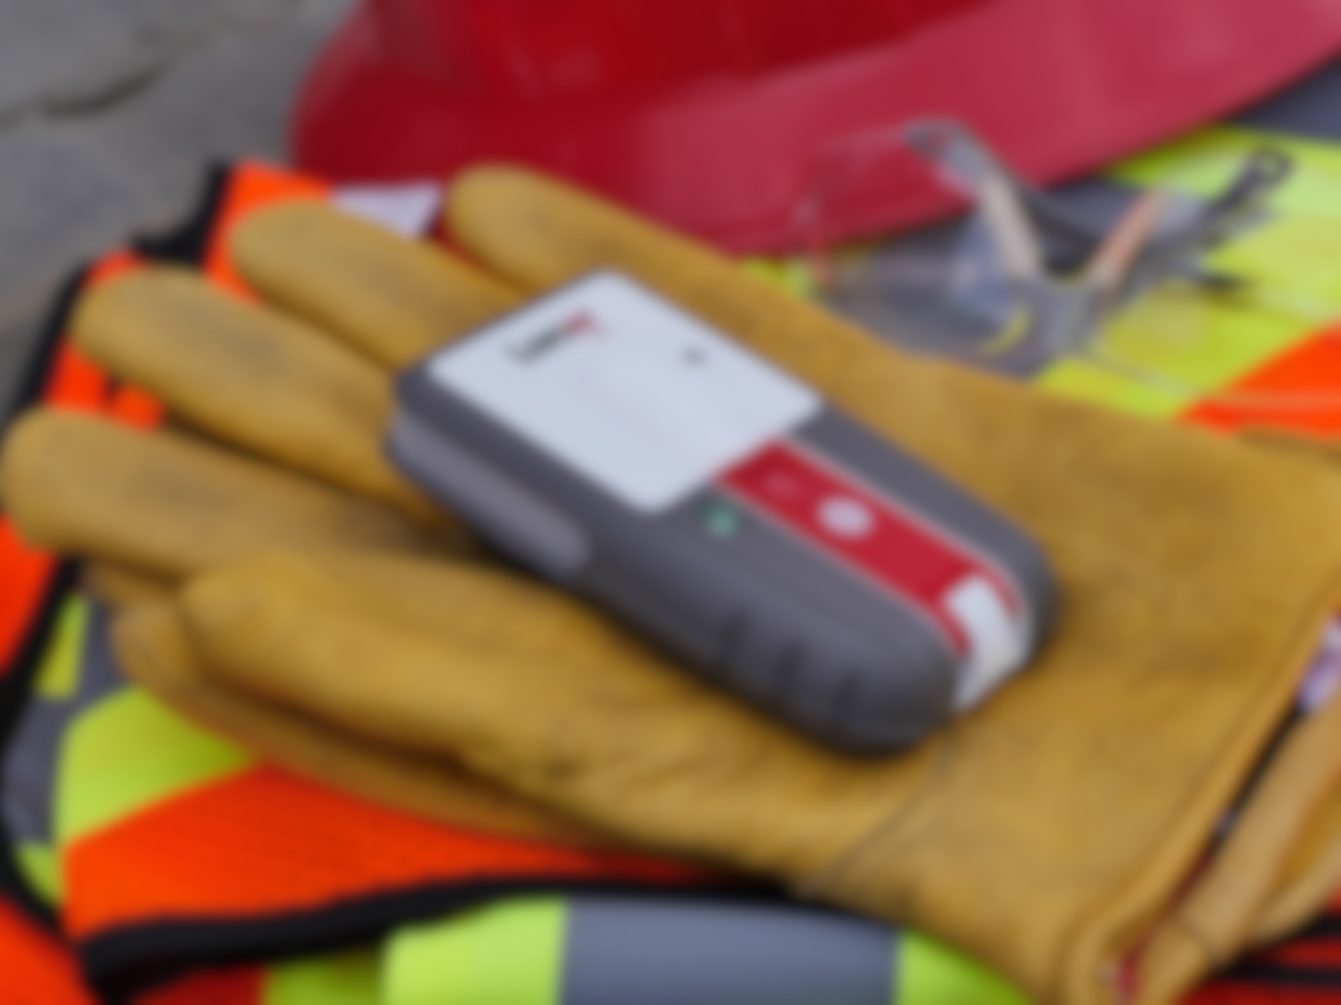
STARTING YOUR SHIFT
Notes:
Questions?
So now we’re going to talk about what you’re going to do when starting your shift and discuss how to properly set up and turn on your devices for proper use.

Slide 6
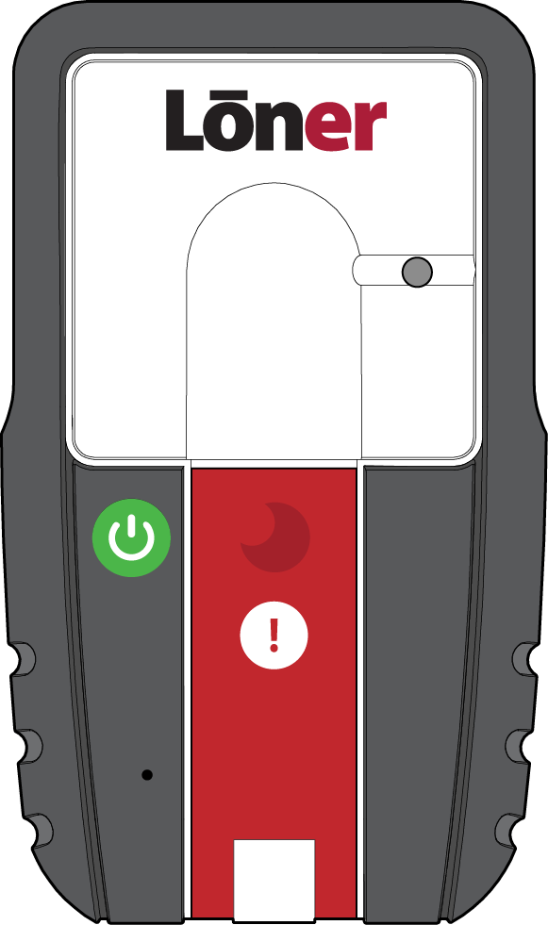

STARTING YOUR SHIFT
TURNING ON YOUR LONER
Press the power button
The green SureSafe light will blink until it is connected to the Blackline Safety Network.
Once connected, the light will be SOLID GREEN.
This means your safety is
now monitored.

Slide 7
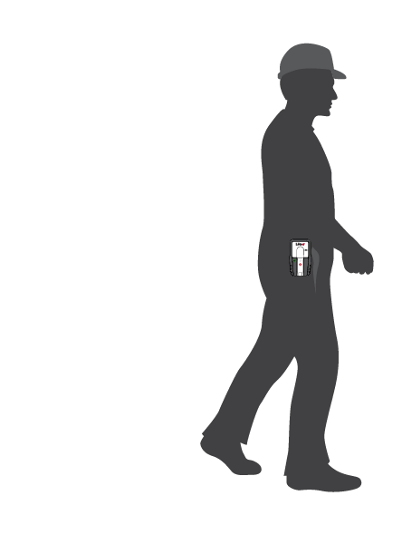
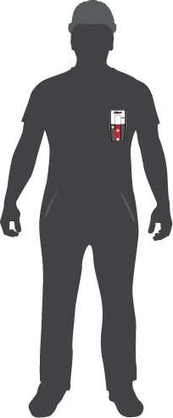
STARTING YOUR SHIFT
WEARING YOUR LONER
Clip the device to the side of your hip or to your chest pocket
Notes:
Once you have turned the device on all that’s left to do is clip the device to your hip pocket, which is the recommended placement of the device.

Slide 8
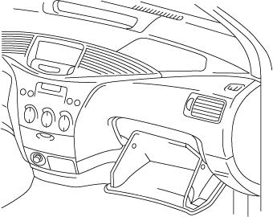

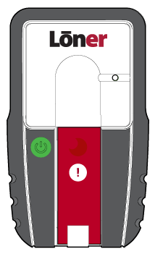


STARTING YOUR SHIFT
Do not leave Loner unattended when powered on
This can lead to false alerts
Notes:
Wearing the device is an important part of the Loner device’s functionality. While Loner device is on, NEVER leave unattended. The automatic alerts on the device (such as No Motion) can be activated and cause false alerts.

Slide 9

DURING YOUR SHIFT
Notes:
.

Slide 10
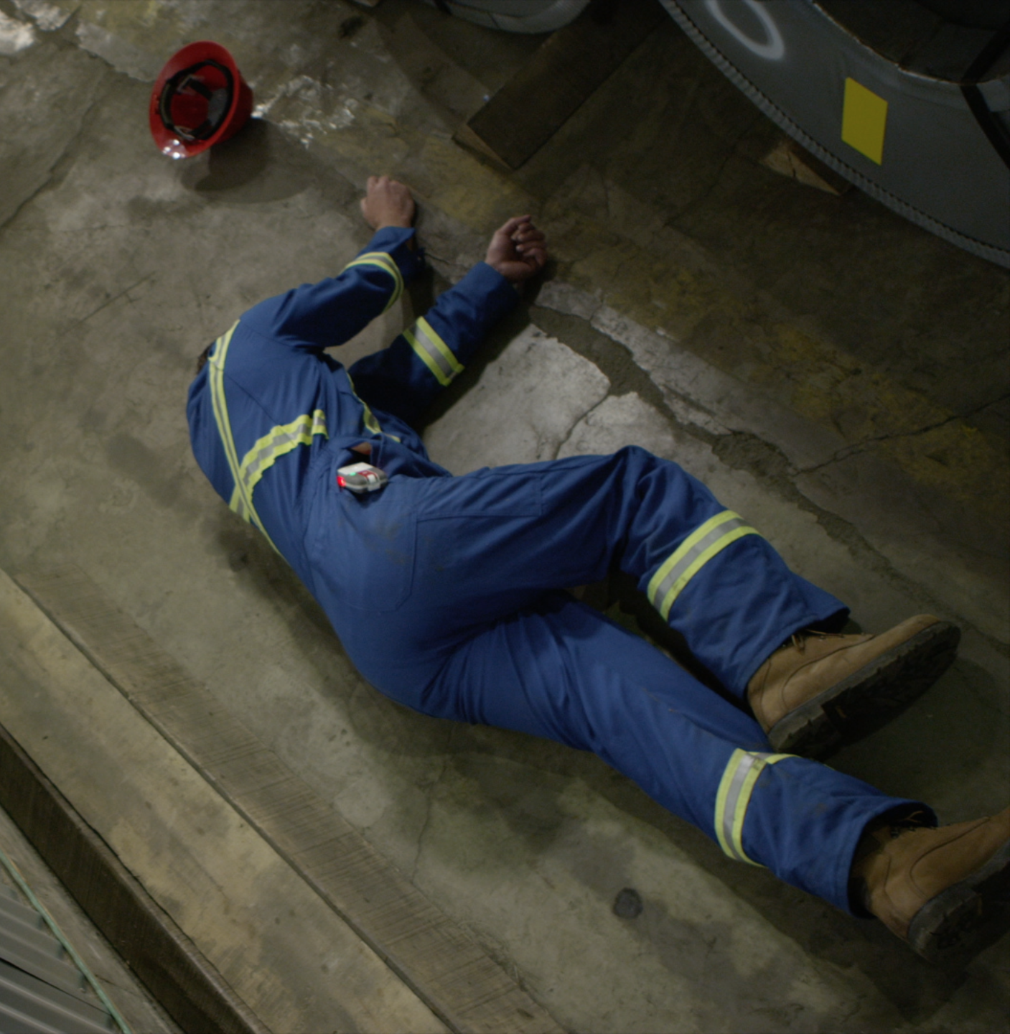
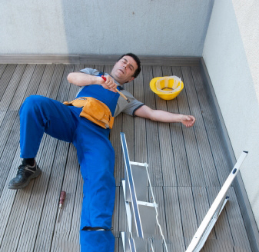
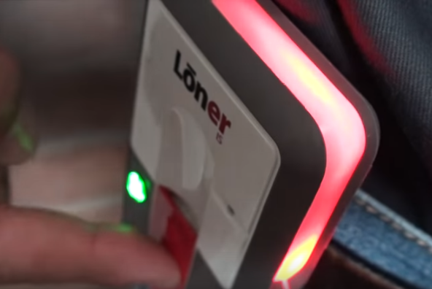

DURING YOUR SHIFT
AUTOMATIC FEATURES
During your shift, the device may ask you to confirm that you are OK when it detects one of the following:
No-motion
Fall detection
Check-in

Slide 11
DURING YOUR SHIFT
AUTOMATIC FEATURES – IF YOU’RE OK
No-motion
Fall Detection
Check-in
Pending Alarm
If you’re OK press the confirm button on the latch
This returns Loner to normal function.
No notification is sent.

Slide 12

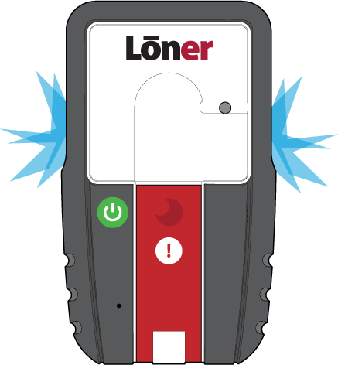

DURING YOUR SHIFT
AUTOMATIC FEATURES – IF YOU CAN’T CONFIRM
No-motion
Fall Detection
Check-in
Pending Alarm
If you can’t press the confirm button after a certain period of time, the device will go into high alarm
Once an alert is acknowledged by monitoring personnel, the loner will display a blue light
The high alarm can be silenced by pressing and holding the button. The alert notification still remains active.
This sends an alert notification

Slide 13
DURING YOUR SHIFT
PRE CHECK-IN
Before pre-check in
Check-in timer reset
00:54:34
2:00:00
To do this, press and hold the latch for two vibrations. This will reset the check-in timer before the automatic alarm sounds.
Your device will automatically check you in if you are driving over 35 km/h.

Slide 14
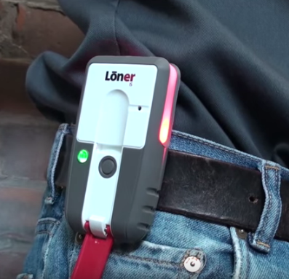
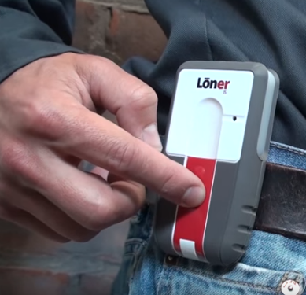
DURING YOUR SHIFT
MANUAL FEATURES
During your shift, you may need to request help using one of the manual features:
Emergency alert
(Audible)
Silent alert

Slide 15
DURING YOUR SHIFT
Emergency alert
Request help by pulling down the latch
An alert notification will be sent to monitoring personnel
The high alarm can be silenced by pressing and holding the button. The alert notification still remains active.
Once an alert is acknowledged by monitoring personnel, the loner will display a blue light

Slide 16

DURING YOUR SHIFT
Silent Alert
(No audible or visual alarm is generated on the Loner device)
An alert notification will be sent to monitoring personnel
No alert acknowledged blue light
will be displayed on the device during a silent alert even if monitoring personnel have acknowledged the incident
Press the confirm button until the vibration stops
(two full vibration pulses ~5 sec.)

Slide 17

RECEIVING A VOICE CALL

Slide 18
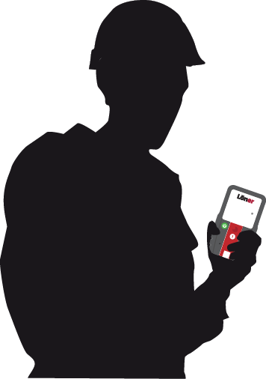
RECEIVING A VOICE CALL
RECEIVING A VOICE CALL
This is the safety monitoring center. We had an alert from your device.
That was a false alarm. I do not require assistance.
*BEEP*
Understood. I will go ahead and resolve your alert.
*BEEP*
A voice call can be made by monitoring personnel directly to the device. After an alert is triggered the device will beep once when a call is connected.
Once the call is connected you can speak back and forth to monitoring personnel. When the call has ended the device will beep once more.

Slide 19
RECEIVING A VOICE CALL
RECEIVING A VOICE CALL – AFTER A SILENT ALERT
…
When a silent alert is generated, monitoring personnel can still connect with the Loner device. However the Loner will not beep and it will be in a ‘listen only’ mode.

Slide 20
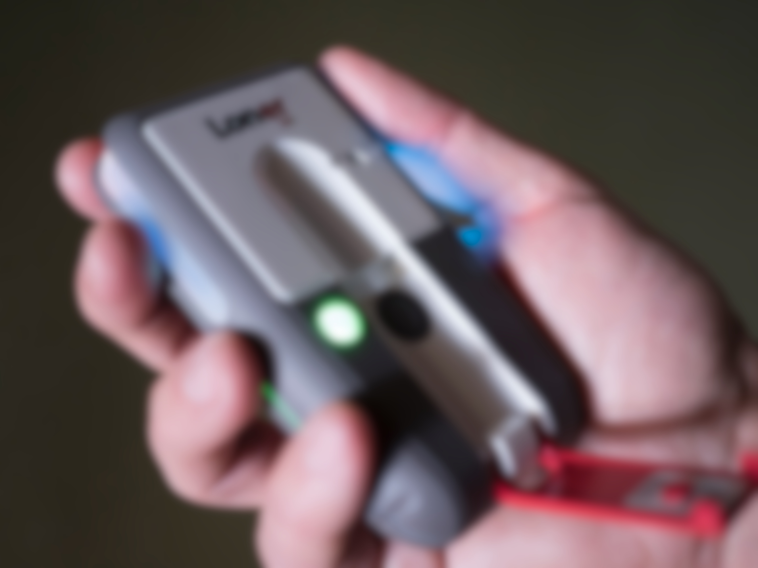
NOTIFICATIONS

Slide 21




NOTIFICATIONS
Link lost alarm
Low battery alarm
Your Loner will notify you if it loses cellular communication.
Your Loner device is configured to signal to you when the battery falls below a certain configured percentage
SureSafe monitoring light
BLINKING
Your Loner SureSafe light will begin blinking to confirm that your safety is not being monitored.
If configured, the device may initiate a link lost alarm.
Low battery alarm is characterized by a short beep and a quick flash every 5 minutes. Charge your device as soon as possible.

Slide 22

ENDING YOUR SHIFT

Slide 23

ENDING YOUR SHIFT
TURNING OFF YOUR LONER DEVICE
Press the power button until beeping and vibration stops (usually 3 seconds)
The device will begin its shutdown sequence and the SureSafe light will flash and then turn off once your Loner logs off from the Blackline Safety Network.
Your safety is no longer being monitored
Notes:
At the end of your shift, remove the loner from your hip and press and hold the power button for about 3 seconds. The device will go into shutdown sequence. The green light on the Loner device may flash for up to 10 minutes while it disconnects.

Slide 24

ENDING YOUR SHIFT
CHARGING YOUR LONER
Full charge takes approx 4 hours
Battery Life is 20 hours
Insert the charger into the bottom of the device and connect to power source
While the device is charging the red lights on the base will flash
When Loner is charged, the red lights will turn on continuously.
Notes:
It is recommended that you charge your Loner device after every use. Simply plug the charger into the bottom of device, while it’s charging red lights will flash at the base of the device and once it’s fully charged, these lights will be solid red. Charging Loner device from fully dead takes approximately 4 hours.

Slide 25

QUESTIONS?

Slide 26

For more support materials,
Please visit support.blacklinesafety.com
Customer Care: 1-877-869-7212
0045/R4/2016-06-01

